Slide 1

HUMAN IDENTIFICATION FROM FREESTYLE WALKS USING POSTURE-BASED GAIT FEATURE

Slide 2
ABSTRACT
This paper presents a novel approach for human identification based on posture-based gait features derived from freestyle walking. Gait analysis has emerged as a valuable biometric method for recognizing individuals due to its non-intrusive nature and ability to capture unique patterns of movement. Traditional gait recognition methods often focus on the overall motion dynamics, but our approach emphasizes the significance of posture variations throughout the walking cycle, which can provide more distinctive features for identification.
We utilize a combination of motion capture technology and advanced computer vision techniques to extract posture-based features from walking sequences. These features are processed to create a robust representation of an individual’s gait, capturing subtle variations that are often overlooked in conventional analyses.

Slide 3
INTRODUCTION
The system employs machine learning algorithms to classify and identify individuals based on the extracted gait features, demonstrating its potential effectiveness in real-world scenarios.
Experimental results indicate that our proposed method achieves high accuracy in identifying individuals from diverse datasets, highlighting the strength of posture-based gait features in distinguishing between subjects. The findings suggest that incorporating posture analysis into gait recognition systems can enhance their robustness, particularly in uncontrolled environments where traditional methods may struggle. This work paves the way for future research into more advanced gait recognition systems, with potential applications in security, surveillance, and healthcare monitoring

Slide 4
EXISTING SYSTEM
Current human identification systems that utilize gait recognition:
1. Current Focus:
Detect how people move – step length, speed, and walking style.
2. Common Methods: - Silhouette analysis – tracks body outline while walking. - Timing and rhythm – studies step patterns.
3. Main Limitations: - Work well only in controlled environments. - Struggle with different surfaces, footwear, or physical changes. - Similar walkers are often hard to tell apart.
4. Technology Used: - Video and depth sensors track motion. - Hard to detect fine posture differences.
.

Slide 5
4. Technology Used: - Video and depth sensors track motion. - Hard to detect fine posture differences.
.
5. Environmental Challenges: - Need good lighting and fixed camera angles. - Don’t work well in real-world (uncontrolled) settings.
6. Recent Progress: - Machine learning helps improve accuracy. - But posture analysis is still underused, especially in freestyle walking.

Slide 6
DISADVANTAGES
1. Limited Posture Analysis: - Focus mostly on stride and speed - Miss unique posture differences that help recognition
2. Environmental Sensitivity: - Depend on lighting and camera angles - Perform poorly in real-world settings
3. Poor Handling of Walking Variations: - Struggle with changes in footwear, surface, or style - Freestyle walking causes errors
4. Complex and Costly Data Collection: - Use expensive tools like motion capture - Not suitable for everyday use
5. Confusion Between Similar Subjects: - Misidentify people with similar walking styles - Leads to high false positives

Slide 7
PROPOSED SYSTEM
1. Posture-Based Feature Extraction
Focuses on joint angles, limb positions, and body posture during walking
Uses motion capture and computer vision for detailed analysis
2. Machine Learning Integration
Applies deep learning (e.g., CNNs) to recognize individuals
Learns complex patterns in posture across walking styles
3. Robust in Real-World Conditions
Trained on varied environments (lighting, surfaces, etc.)
Works well even in uncontrolled, real-life settings
4. Real-Time Recognition
Identifies people instantly as they walk
Useful for security, smart systems, and surveillance
5. User-Friendly Design
Simple interface for registration and use
Encourages adoption in practical scenarios

Slide 8
ADVANTAGES
1. Higher Identification Accuracy
Captures detailed posture changes
Reduces misidentification by focusing on unique gait features
2. Resilient to Environmental Changes
Works well in real-world conditions (lighting, surfaces, etc.)
Handles unpredictable environments better than traditional systems
3. Natural Walking Style Recognition
Uses freestyle walking to reflect real human behavior
Improves data quality and recognition in everyday situations
4. Real-Time Performance
Identifies individuals instantly as they walk
Ideal for security and surveillance where speed matters
5. Easy to Use
Simple, intuitive interface for user registration and use
Supports wider adoption in practical scenarios

Slide 9
TECHNOLOGIES
1.Motion Capture Systems
Capture detailed movement and posture during walking
Enable precise joint and limb tracking
2. Computer Vision Algorithms
Extract posture features like joint angles and body orientation
Analyze walking sequences frame-by-frame
3. Deep Learning (CNNs)
Learn complex patterns in posture and gait
Classify individuals based on their walking style
4. Machine Learning Models
Support classification and recognition tasks
Improve accuracy across varied walking conditions
5. Real-Time Processing Frameworks
Ensure quick identification while a person is walking
Useful for live surveillance and smart systems
6. User Interface Tools
Create simple and interactive interfaces
Support easy enrollment and identification

Slide 10
SOFTWARE REQUIREMENTS
• System : Pentium IV 2.4 GHz.
• Hard Disk : 40 GB.
• Ram : 512 Mb.

Slide 11
HARDWARE REQUIREMENTS
• Operating system : Windows.
• Coding Language : python.

Slide 12
Modules
Upload Kinect Gait Dataset : This module allows users to upload raw Kinect gait datasets securely into the system. It verifies the data format and integrity to ensure the files conform to expected standards. Proper validation prevents corrupted or incompatible data from entering the pipeline, maintaining the system’s reliability and data consistency for further preprocessing and analysis.
Dataset Preprocessing : The preprocessing module cleans the raw Kinect motion data by filtering out sensor noise and correcting missing or inconsistent values. It extracts the fundamental joint position data and normalizes it to a consistent scale. This step is crucial for improving data quality, reducing bias, and preparing the dataset for accurate feature extraction and subsequent machine learning tasks.
Dataset Train & Test Split : This module splits the processed gait data into training and testing subsets, commonly using an 80/20 ratio. It ensures stratified sampling to maintain class balance across the sets, which is vital for unbiased model training and reliable evaluation. Proper splitting helps avoid data leakage and overfitting while enabling robust performance assessment.

Slide 13
Train Extra Tree Classifier : This module trains the Extra Trees classifier on the training data, leveraging an ensemble of randomized decision trees. The model learns complex patterns and relationships in gait features to accurately classify individuals. Extra Trees often provide strong performance with reduced overfitting risk due to their randomized tree construction process.
Train KNN Classifier : The K-Nearest Neighbors (KNN) training module builds a classifier that labels gait samples based on the majority class of their closest neighbors in the feature space. It is a simple yet effective approach, especially when similar gait patterns cluster together. KNN adapts well to complex gait variations without requiring extensive model training.
Train MLP Classifier : This module trains a Multi-Layer Perceptron (MLP) neural network on the extracted gait features. MLP uses multiple layers of neurons to model nonlinear relationships within the data. Its ability to capture complex patterns makes it well-suited for detailed gait classification tasks, offering flexible learning capacity beyond traditional algorithms.
Generate Comparison Graph: The comparison and visualization module produces graphical summaries of all trained models’ performance metrics such as accuracy, precision, recall, and F1-score. Using libraries like Matplotlib or Seaborn, it creates intuitive charts and plots that help users visually assess which model performs best and facilitates informed decisions for model deployment.

Slide 14
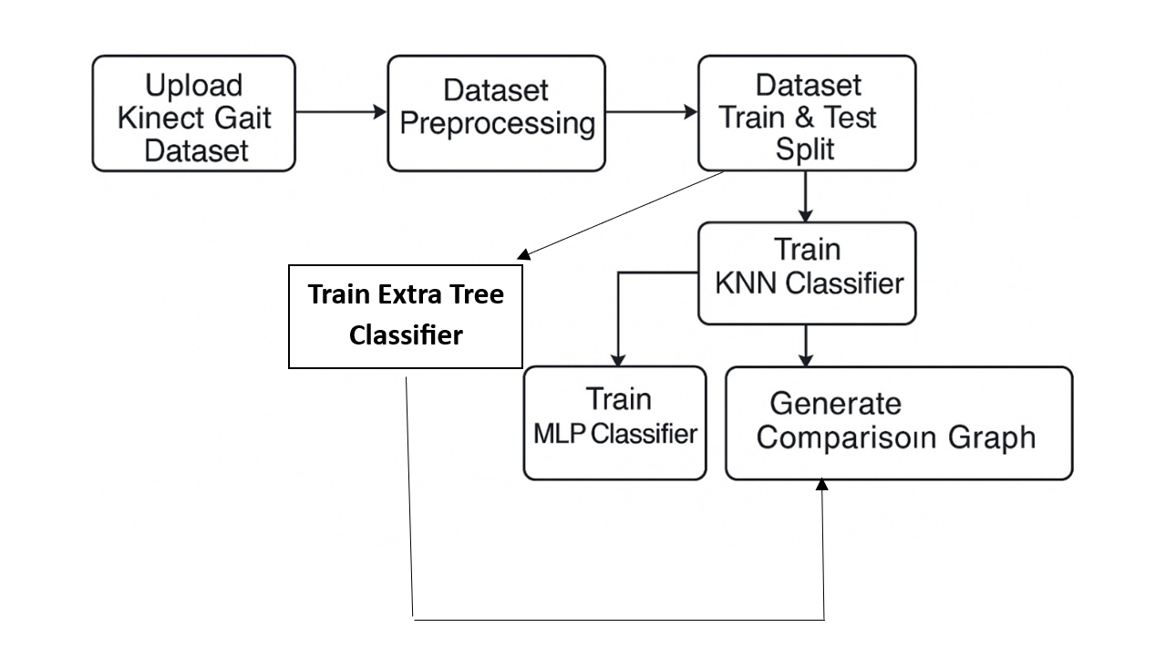
System Architecture

Slide 15
UML Diagrams
Class Diagram
Use case Diagram
Sequence Diagram
Activity Diagram

Slide 16
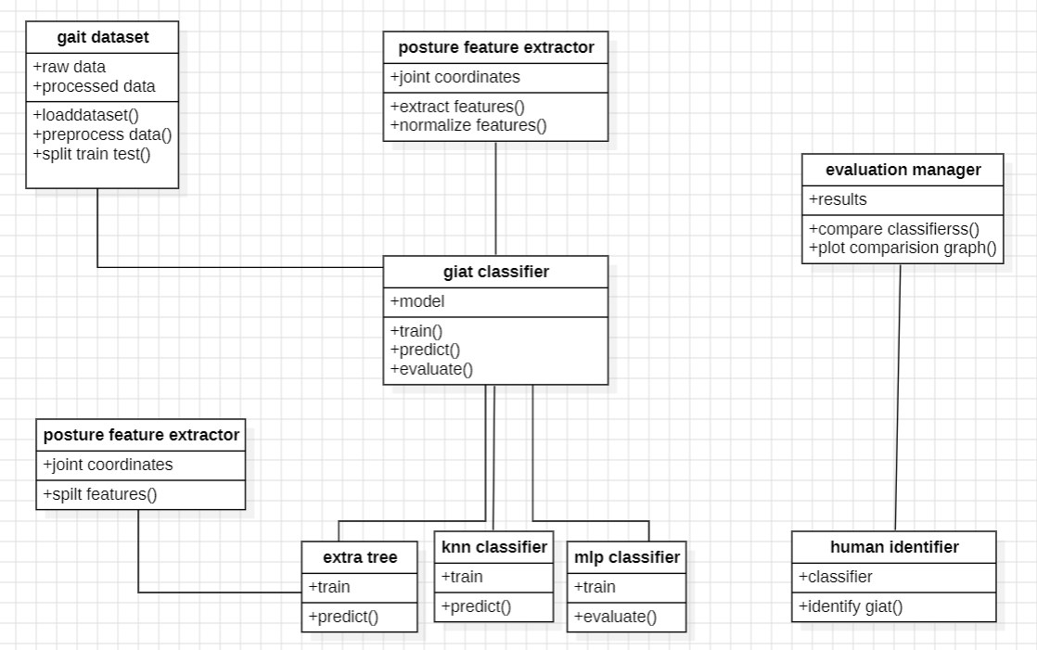
Class Diagram

Slide 17
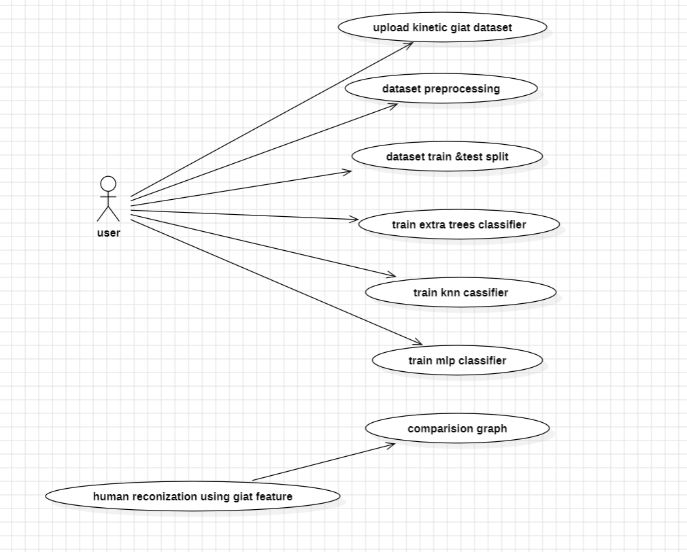
Use Case Diagram

Slide 18
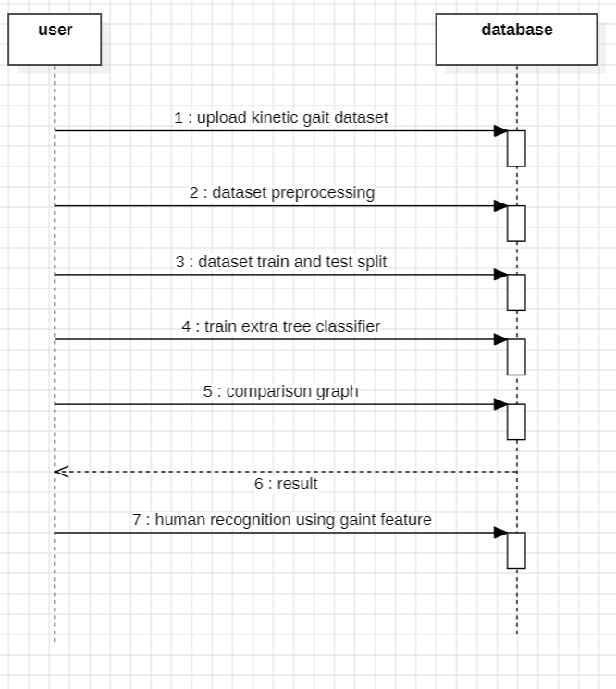
Sequence Diagram

Slide 19
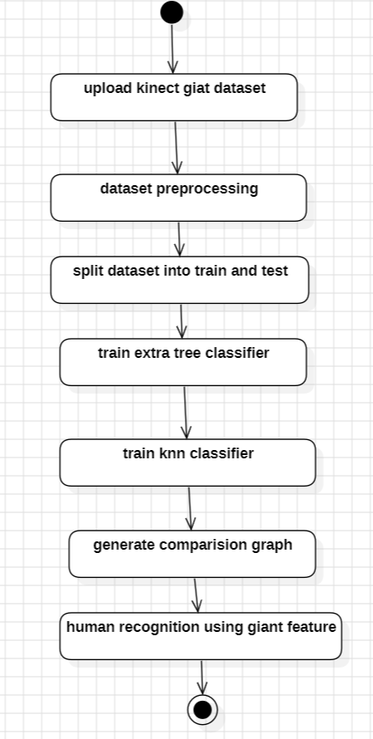
Activity Diagram

Slide 20
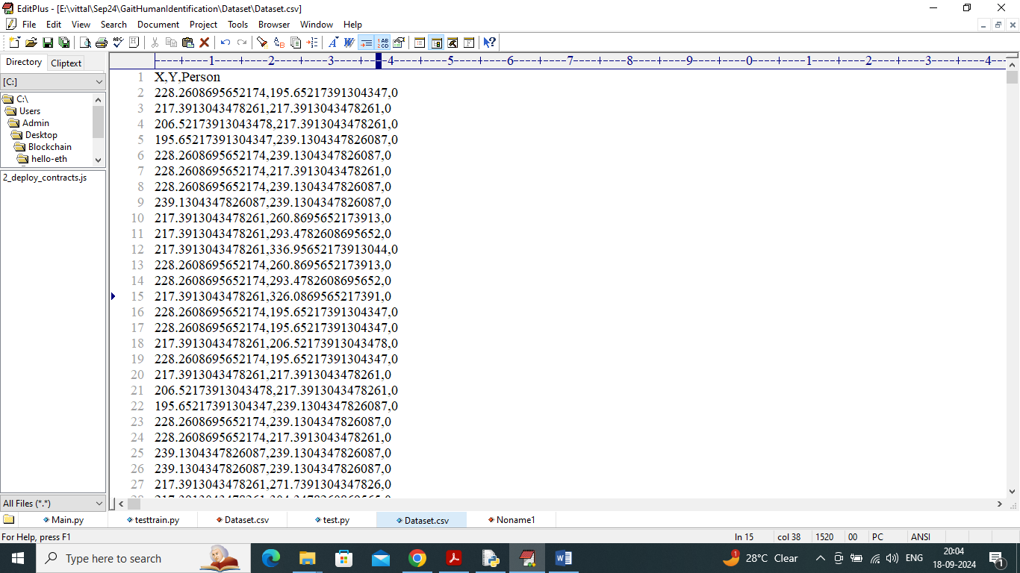
Outputs
In above dataset screen X and Y values represents posture movement and last column contains person ID as the class labels from 0 to 3.

Slide 21
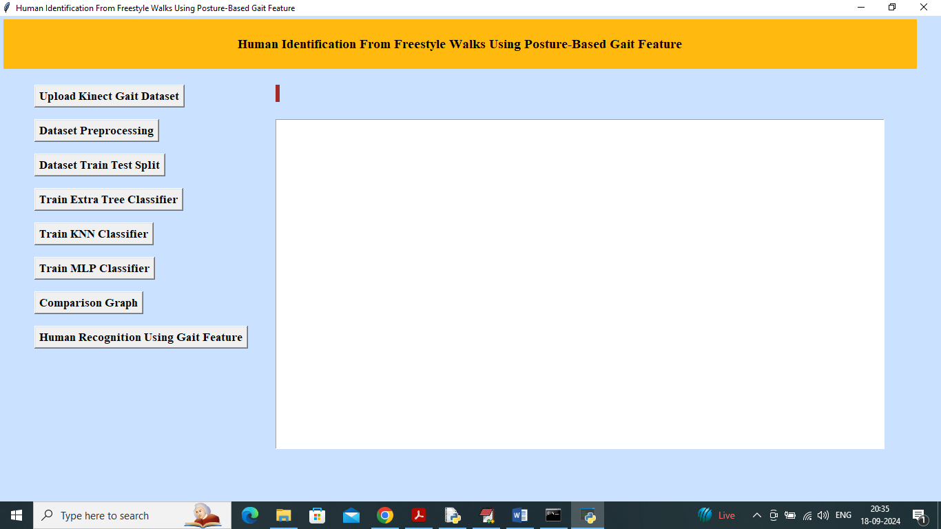
To run project double click on ‘run.bat’ file to get below screen
In above screen click on ‘Upload Kinect Gait Dataset’ button to upload dataset and get below output

Slide 22
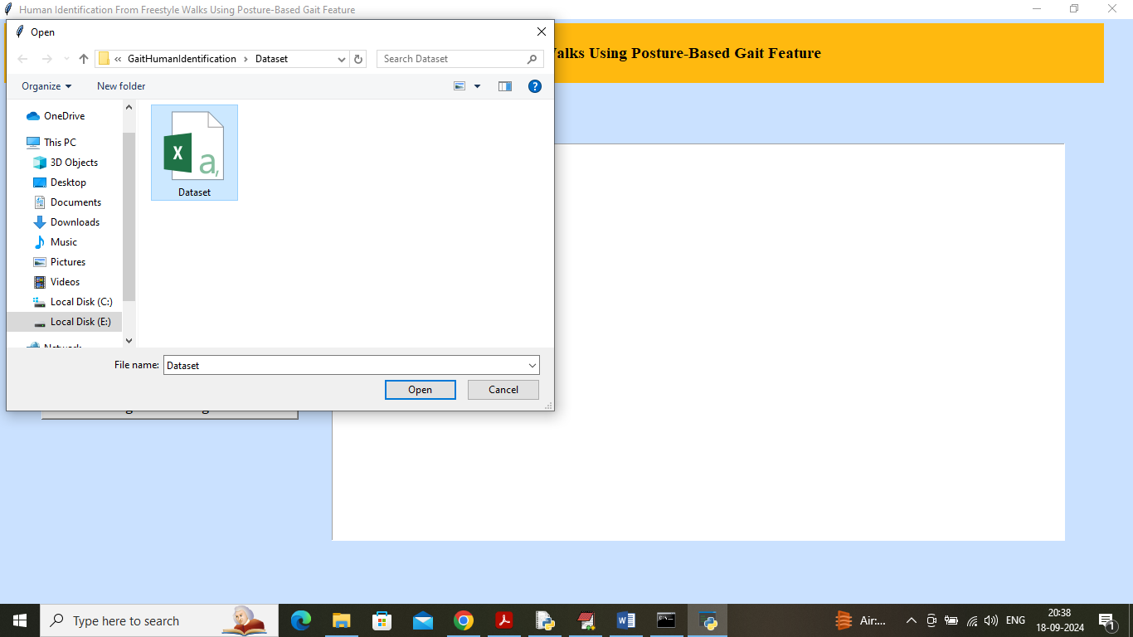
In above screen selecting and uploading Dataset and then click on ‘Open’ button to load dataset and get below output

Slide 23
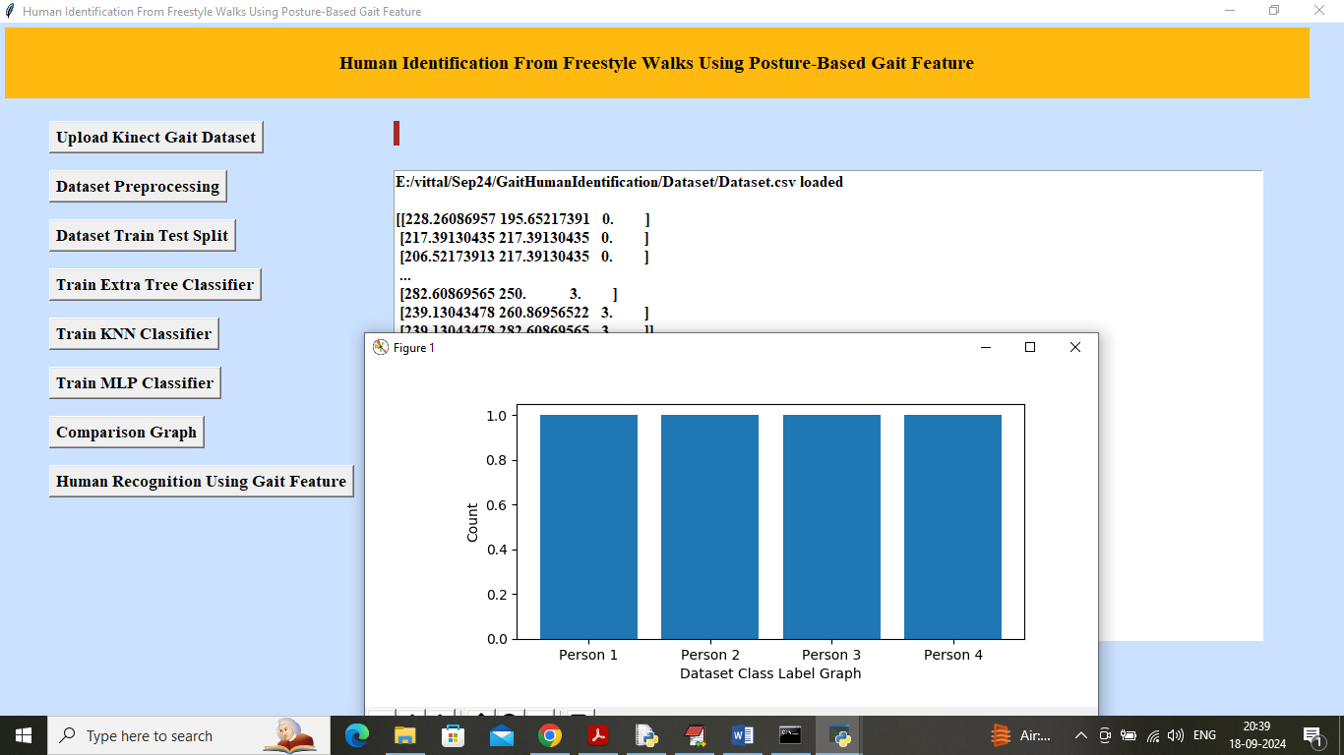
In above screen dataset values loaded and in graph x-axis represents number of Persons and y-axis represents number of posture Gaits values exists for that person. Now close above graph and then click on ‘Dataset Pre-processing’ button to shuffle and normalized dataset values and get below output

Slide 24
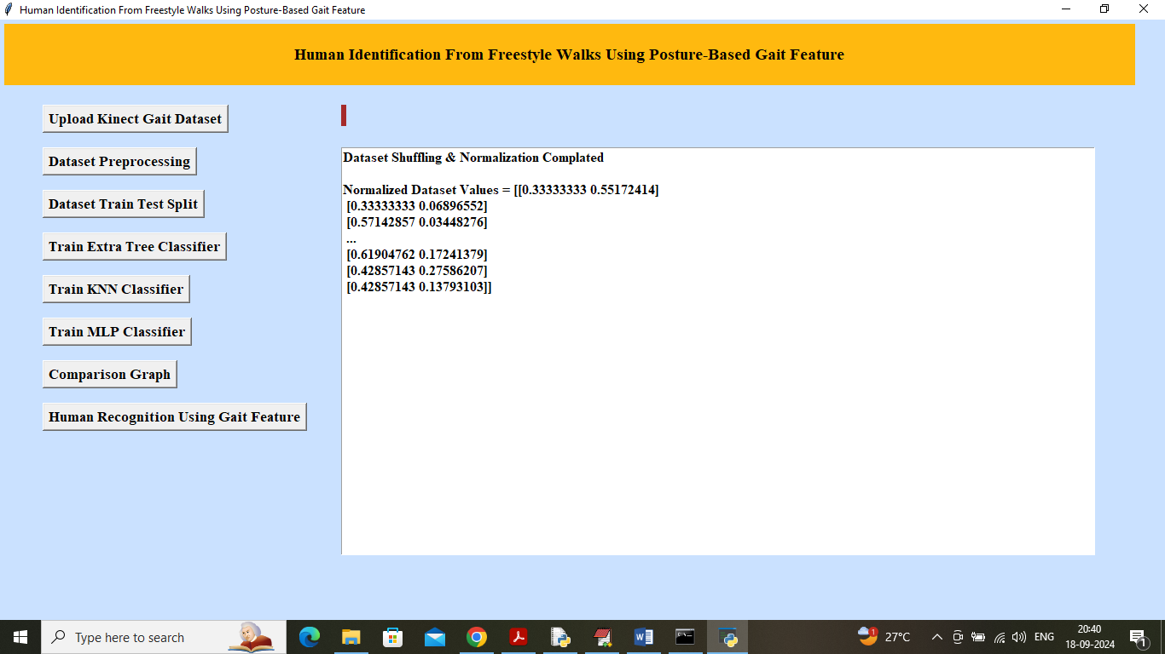
In above screen dataset processing completed and can see normalized dataset values and now click on ‘Dataset Train Test Split’ button to split dataset into train and test and then will get below output

Slide 25
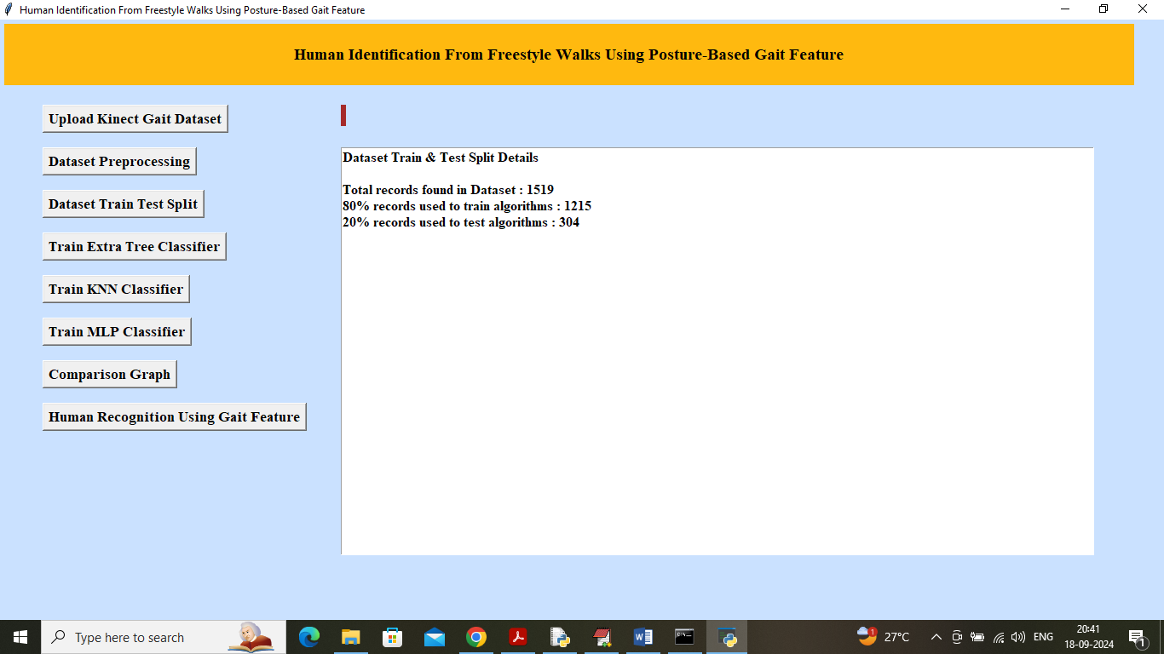
In above screen can see total dataset records and then can see training and testing size. Now click on ‘Train Extra Tree Classifier’ button to train algorithm and get below output

Slide 26
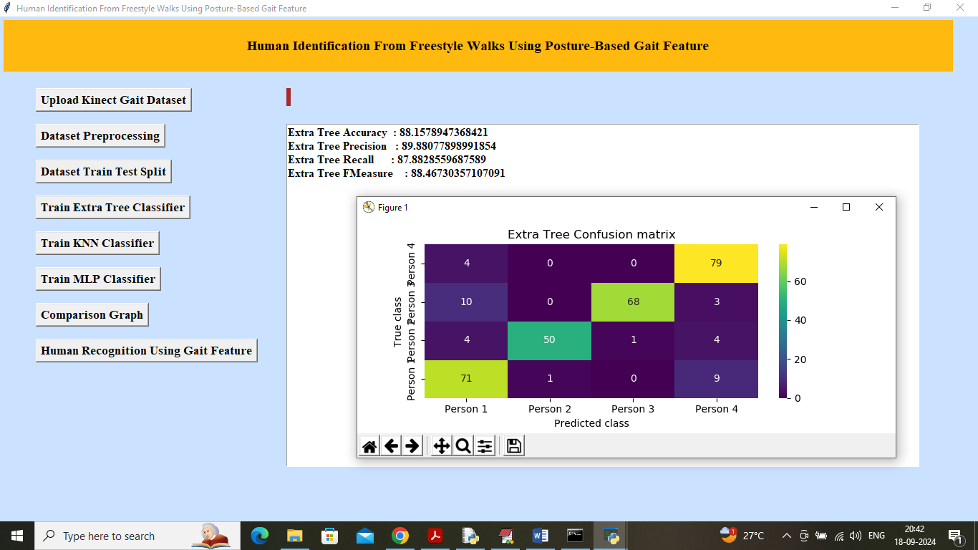
In above screen Extra Tree Classifier Completed and it got Validation accuracy on test data as 88% and can see other metrics like precision, recall and FSCORE. In confusion matrix graph x-axis represents Predicted Labels and y-axis represents True Labels and then all different colour boxes in diagonal represents correct prediction count and remaining boxes got incorrect prediction count which are very few. Now close above graph and then click on ‘Train KNN Classifier’ button to get below output

Slide 27
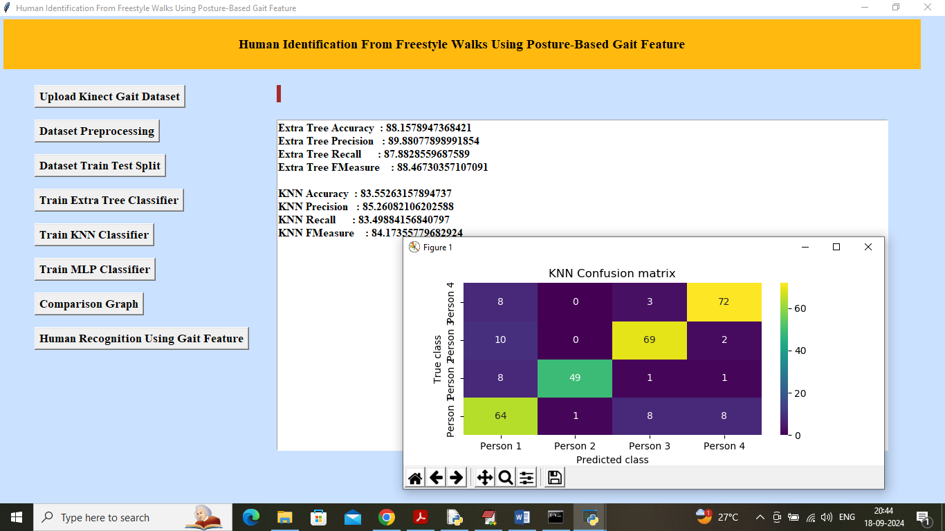
In above screen KNN got 83% accuracy and can see other metrics output also and now click on ‘Train MLP Classifier’ button to get below output

Slide 28
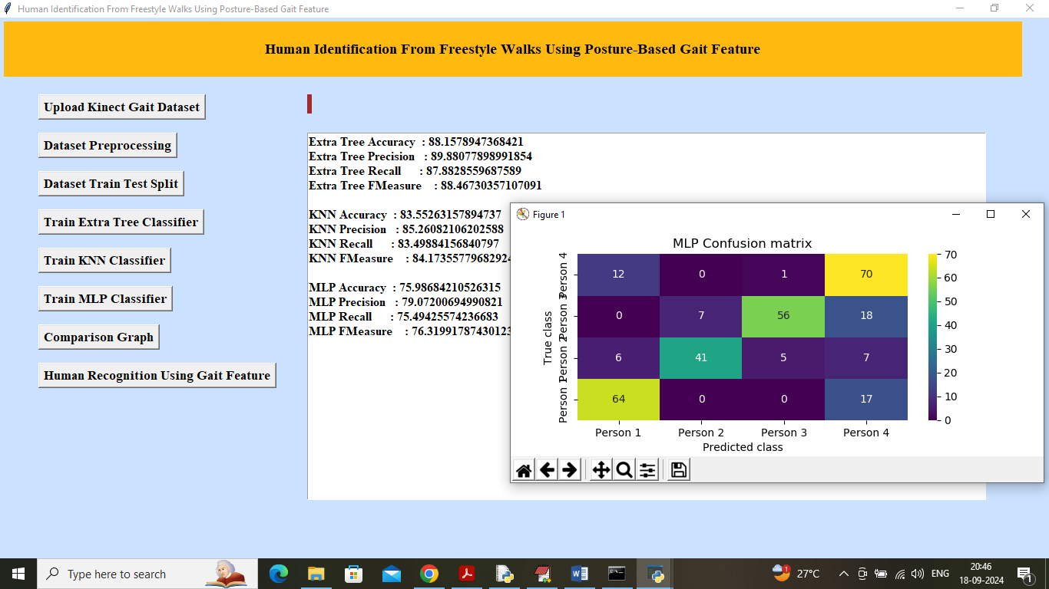
In above screen MLP got 75% accuracy and now click on ‘Comparison Graph’ button to get below graph

Slide 29
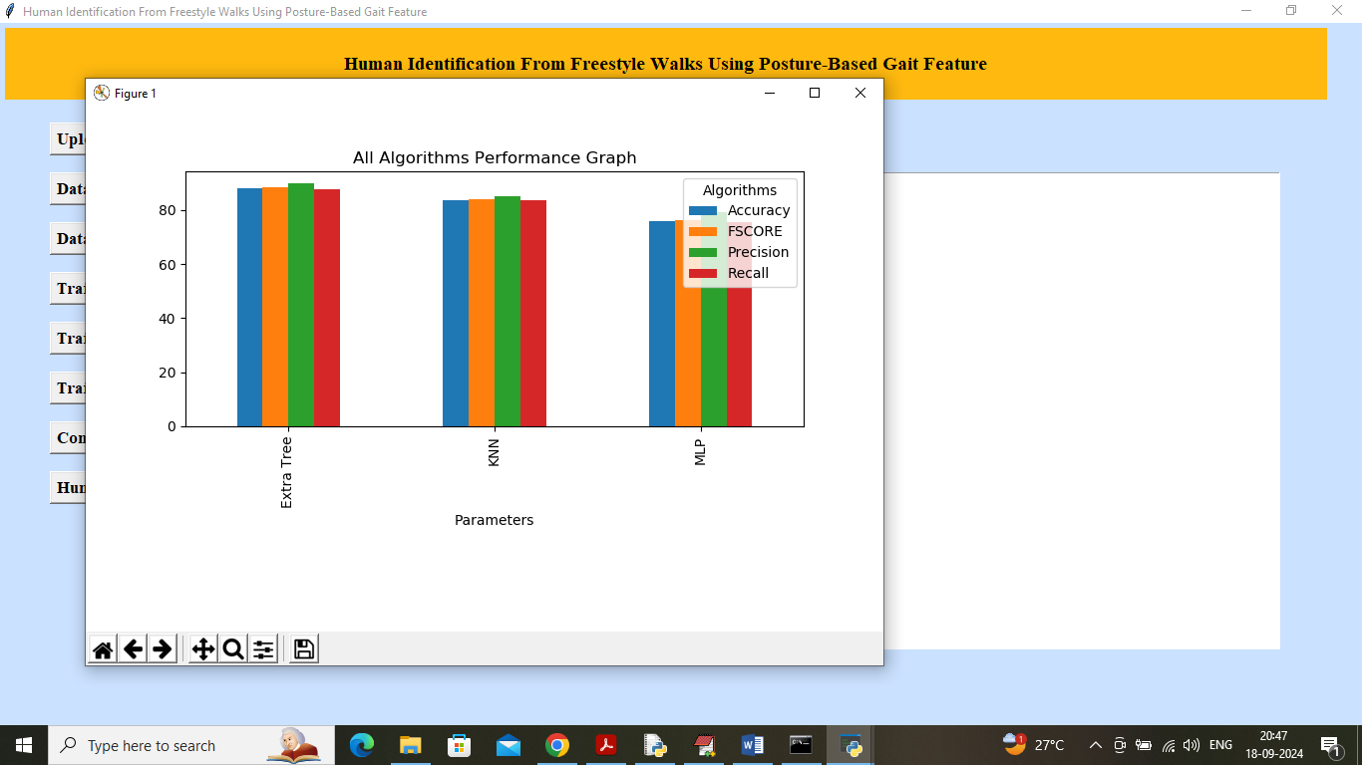
In above graph x-axis represents algorithm names and y-axis represents accuracy and other metrics in different colour bars and in all algorithms KNN and Extra Tree got high performance. Now click on ‘Human Recognition Using Gait Feature’ button to upload test video and get below page

Slide 30
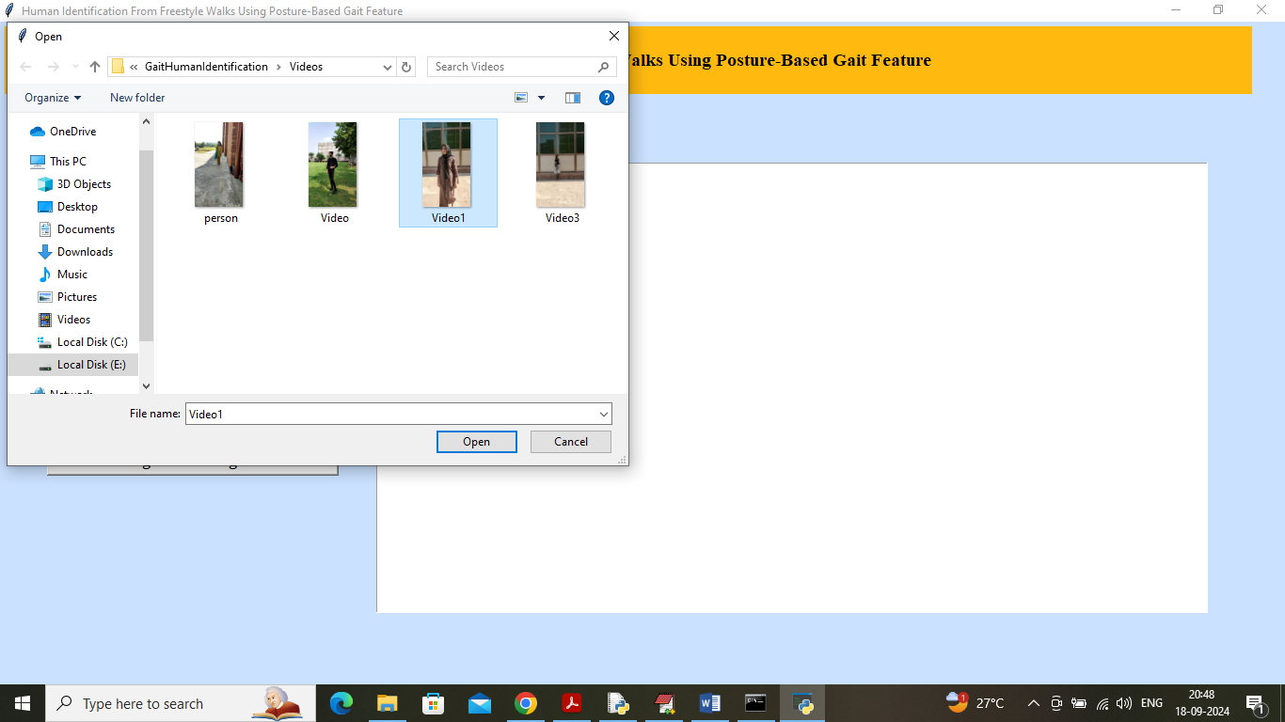
In above screen selecting and uploading TEST video and then click on ‘Open’ button to start playing video and start recognition based on Gait features

Slide 31
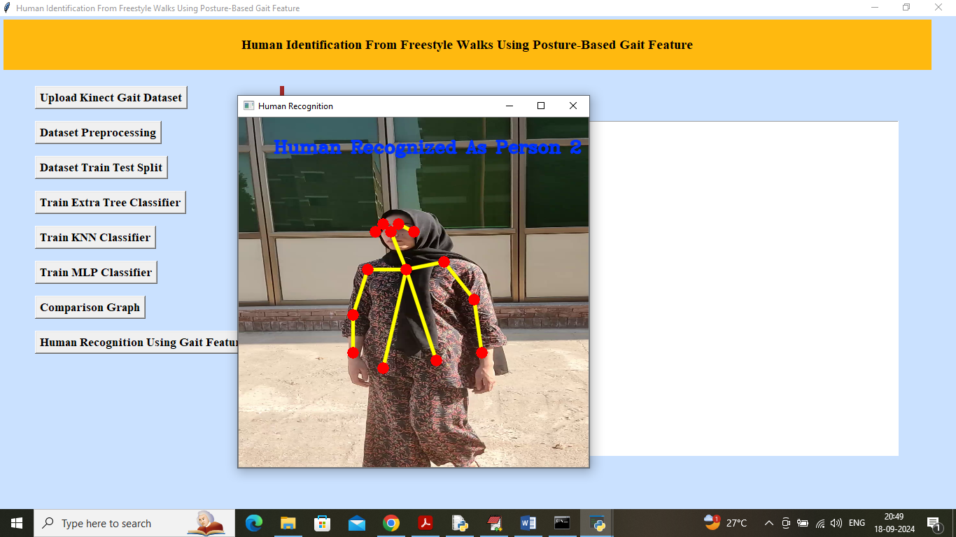
In above screen person is walking and then application start collecting Gait features which you can understand by seeing yellow lines and red circles and then in blue colour can see ‘Person Recognized as ID 2’. Similarly you can upload and test other videos

Slide 32
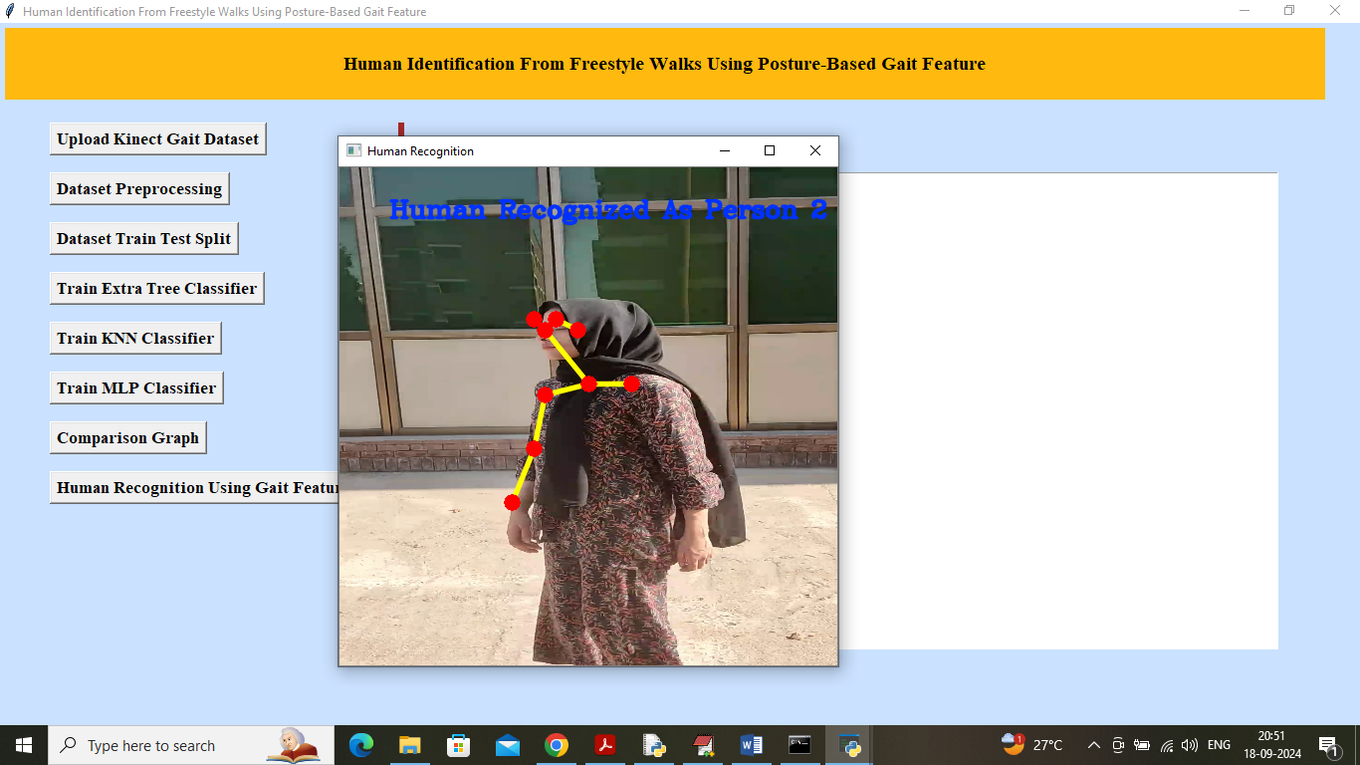
In above screen you can video is playing and user is walking and algorithm recognizing person based on Gait features and while playing video you can press ‘q’ key from keyboard to stop playing. Now uploading and testing other video

Slide 33
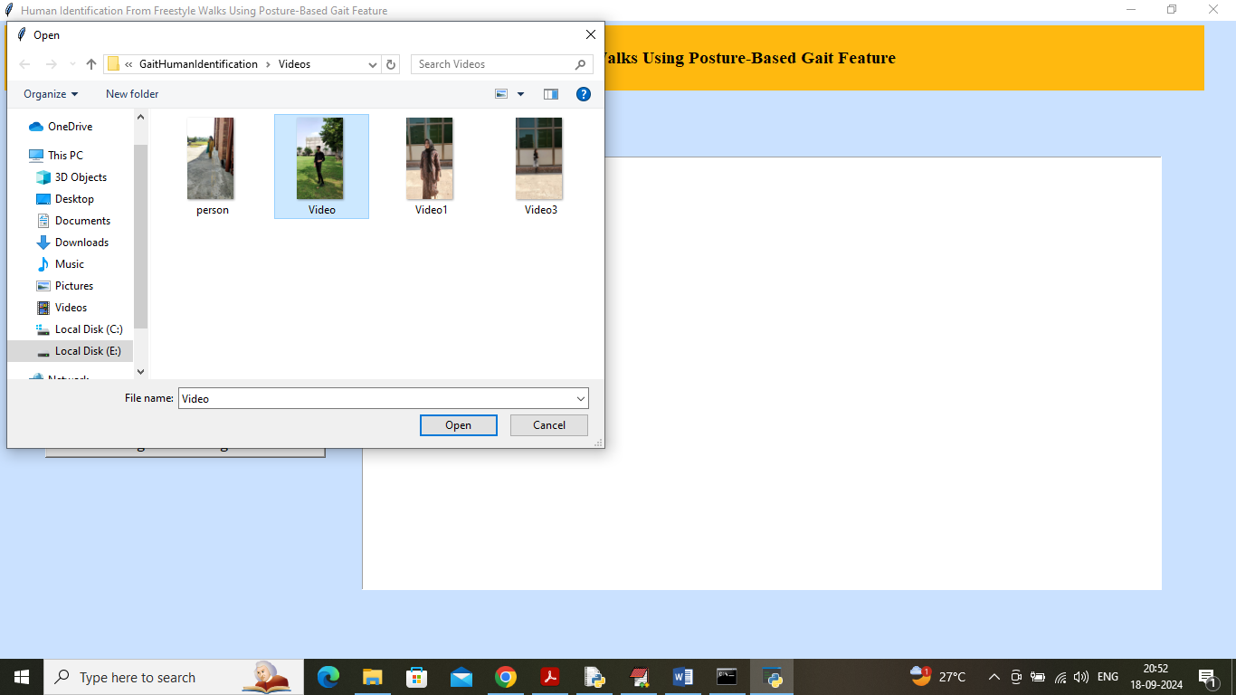
In above screen uploading another video and below is the output

Slide 34
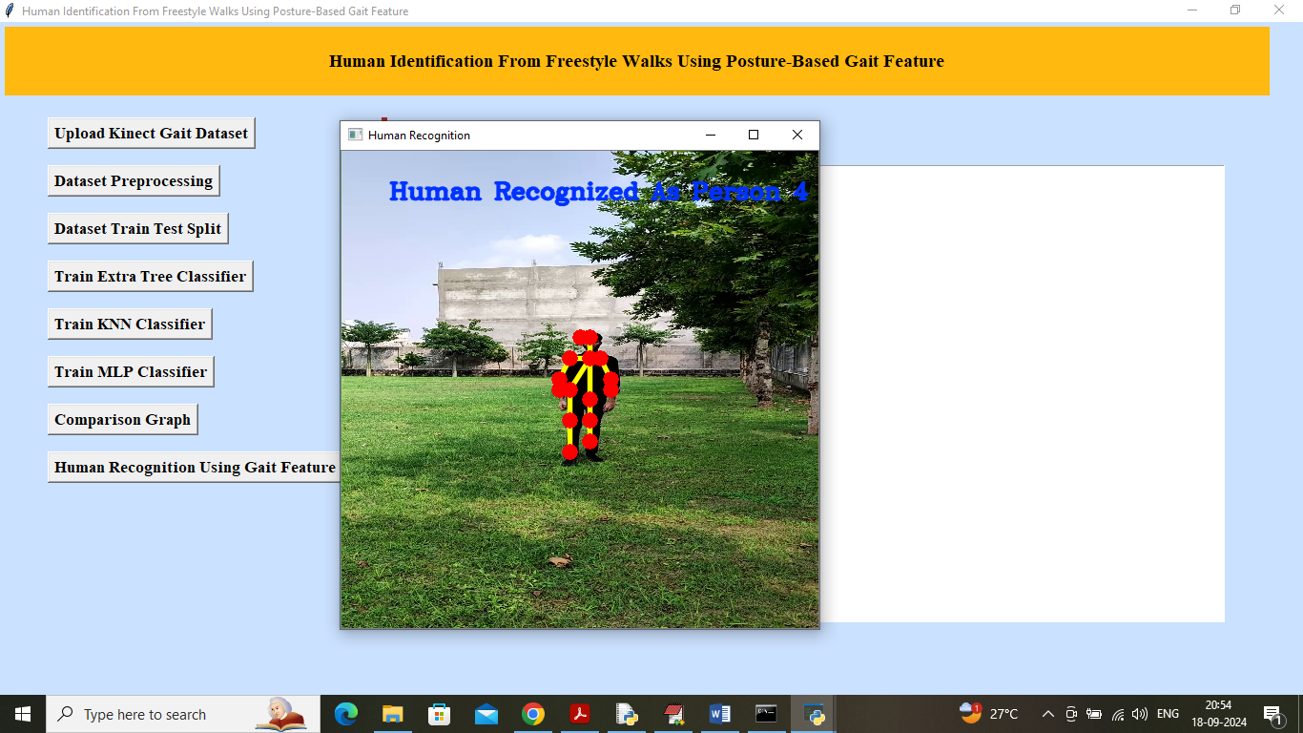
In above screen another recognized as person 4

Slide 35
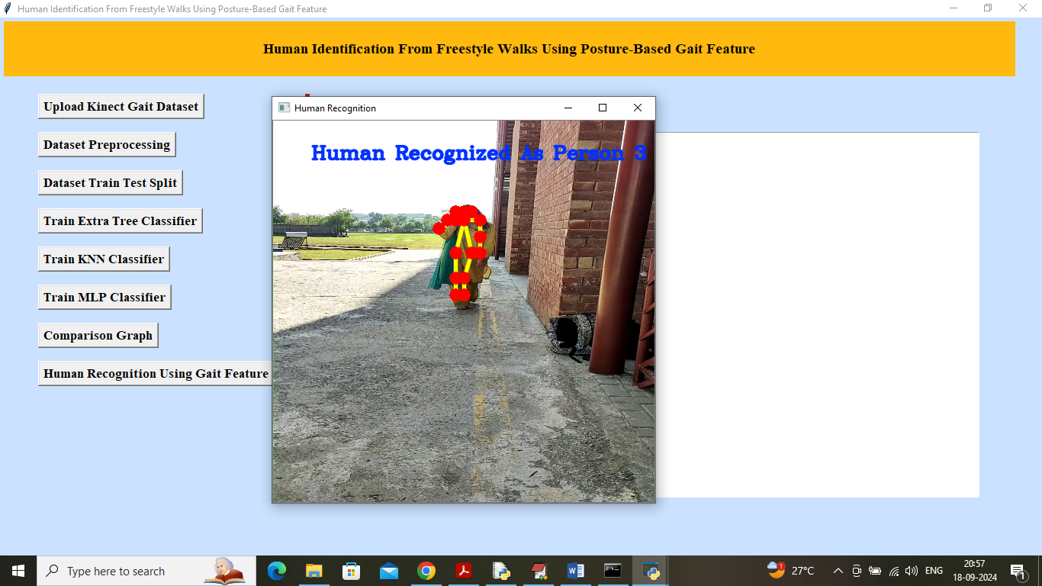
In above screen another video person recognized as Person 3. Similarly you can upload video and recognized person based on Gait features

Slide 36
Conclusion
In conclusion, the Human Identification from Freestyle Walks Using Posture-Based Gait Features system represents a significant advancement in biometric identification technology. By focusing on the unique characteristics of an individual's gait, particularly through the analysis of posture-based features, the system demonstrates a robust and non-intrusive approach to identifying individuals in various environments. This is particularly valuable in real-world scenarios, where traditional identification methods may be less effective due to changes in attire, accessories, or physical appearance. The ability to identify individuals based on their walking patterns offers a new dimension to biometric systems, enhancing security measures in public spaces, healthcare monitoring, and personalized user experiences.

Slide 37
THANK YOU

